Slide 1
The Linux Command Line Chapter 12
A Gentle Introduction to vi
Prepared by Dr. Reyes, New York City College of Technology

Slide 2
vi Editor
vi is a text editor that is always available in Unix/Linux systems.
It is a light way text editor
It is very fast
It is difficult to use compared to other text editors such as gedit and nano
Modern versions of Linux include vim, that is a user-friendlier version of vi
Has two modes:
Editing or Insert mode (pressing i or a)
Command mode (pressing ESC key)

Slide 3


Starting vi
vi – Command to start the vi editor
To start vi and create a new file use vi followed by the file name. For example:

Slide 4

Saving Your Work
To save your work you need to be in Command mode (press ESC key)
:w - command in vi to write or save your work

Slide 5


Exiting vi
:q – command used to quit vi
:q! – command used to quit vi without saving any changes
If in Insert mode, press the ESC key to go to Command mode

Slide 6
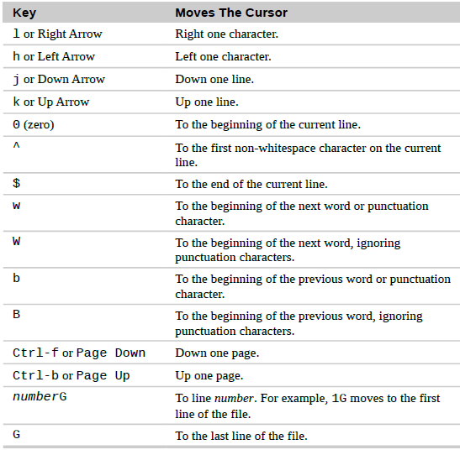
Navigating in vi

Slide 7
vi Editor
i – vi command used to insert text
a – vi command used to append text
A – vi command to append at the end of the line
After using i, a or A vi will switch to Insert mode and then you will be able to type.

Slide 8
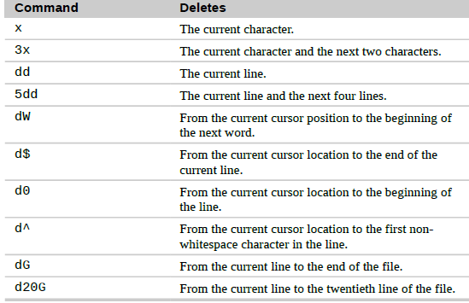
Deleting in vi

Slide 9
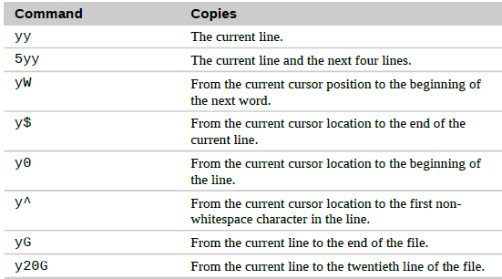
Copy (yank) and paste in vi
p – vi command used to paste text
u – vi command to undo

Slide 10

Searching in vi
f – vi command to search a single character in the current line.
/ – vi command to search a word or phrase in the entire file.
Example for searching the word “Line”

Slide 11
vi Resources
vim Tutorial: http://www.openvim.com/tutorial.html
vim Adventures Game: http://vim-adventures.com/
vim Genius: http://www.vimgenius.com/

